Slide 1
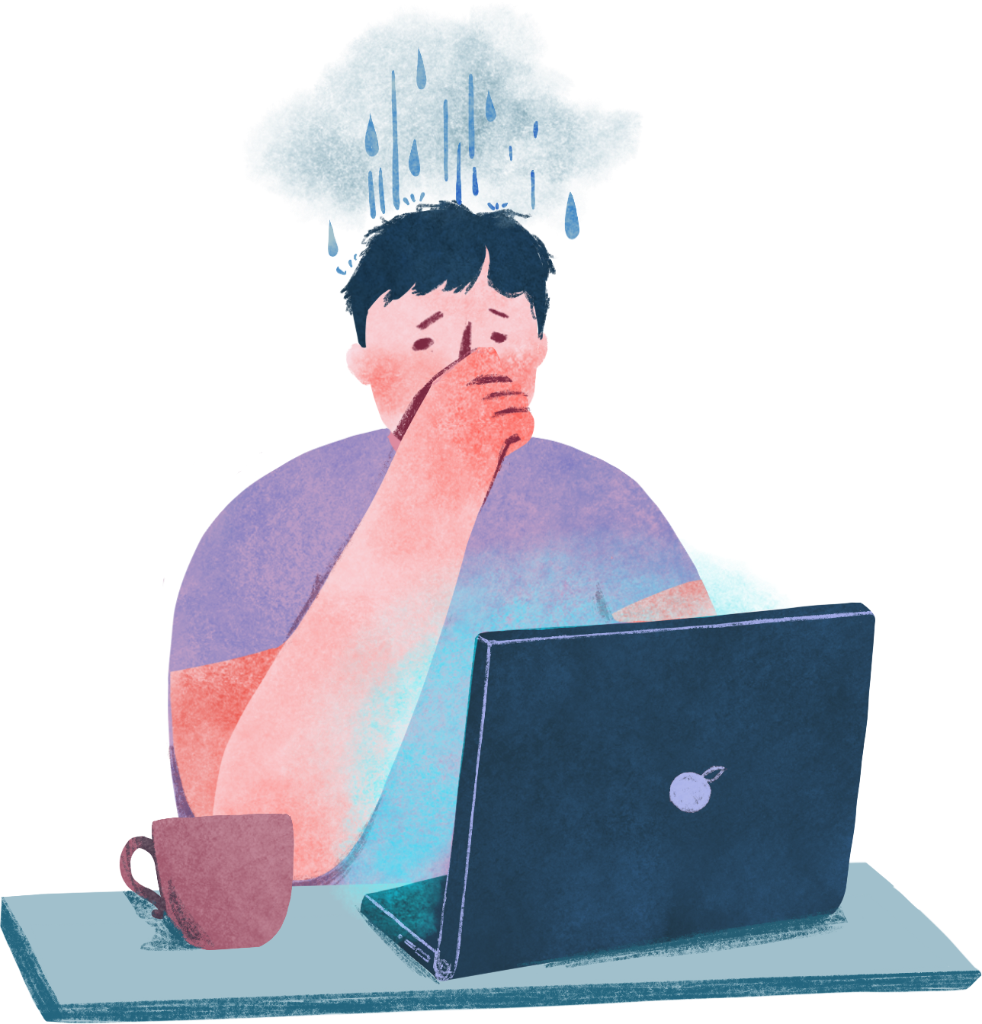

What is Stress?
Remember to click Enable Content to access the videos and Notes to see additional information below
Lecture 1
Notes:
Designed and created by Dandi Yang. Do not duplicate or upload with the express written permission of the author.

Slide 2
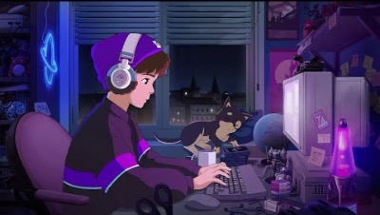
Notes:
Before we begin, please feel free to open up this video, keep in the background and and enjoy some chill beats as you navigate through this lecture. Or watch the video in between work sessions to destress and refocus.

Slide 3
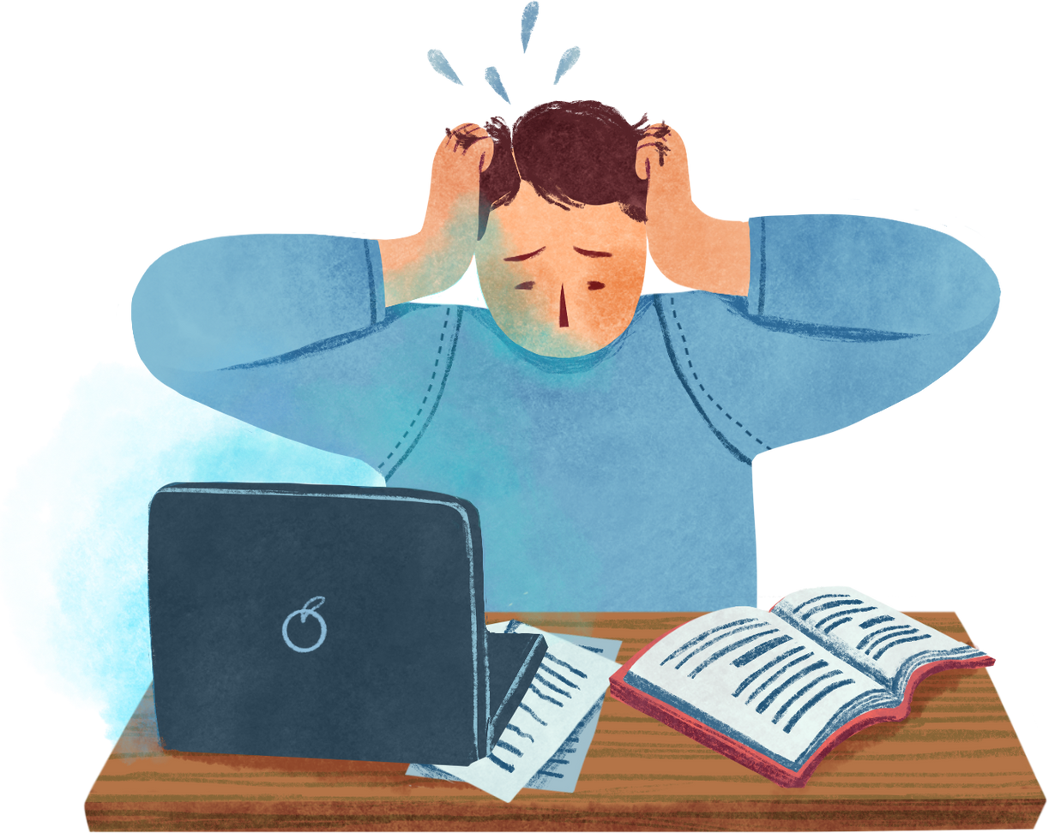
Overview
Pioneers of Stress Research
Types of Stress
Stress Reactivity
Defining Stress: Eustress and Distress
Goals of Stress Management

Slide 4
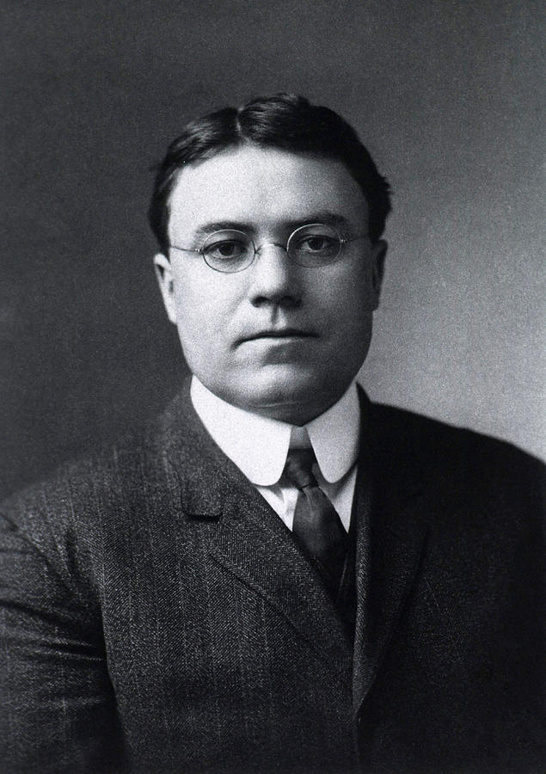
Walter Cannon
First to describe the effects of acute stress
Termed this stress reaction as the fight-or-flight response:
The body’s stress reaction that includes a quick increase in heart rate, respiration, blood pressure, and serum cholesterol
A primitive response
Notes:
Prehistoric people instinctively knew to fear dangerous situations, such as confrontation with large predators. Humans and animals have maintained those automatic reactions to potentially dangerous situations. In some instances, these reactions are still very useful. When presented with a dangerous situation, our instincts still tell us we must be ready to react swiftly: to fight or to flee.
The fight-or-flight response, also called the acute stress response, is an automatic reaction to a stressful and potentially dangerous situation. Our brains react quickly to keep us safe by preparing the body for action. Just like animals, humans react to the acute stress by either fighting the threat or fleeing from it.
When confronted by a threat, the brain begins to prepare the body for action without conscious thought. The brain activates the sympathetic nervous system, the part of the nervous system that stimulates the body and mobilizes energy resources for action.

Slide 5
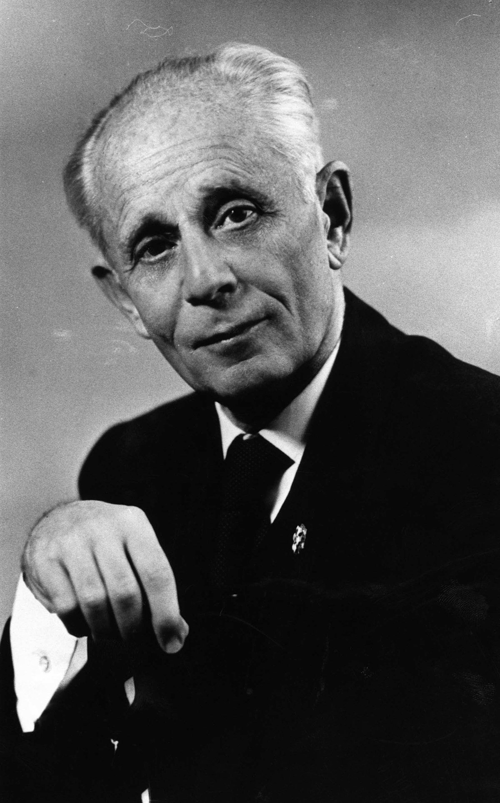
Hans Selye
Studied the effects of long-term (chronic) stress
Summarized his findings by proposing a three-phase process called the general adaptation syndrome, a three-stage stress reaction:
Alarm reaction
Stage of resistance
Stage of exhaustion
Notes:
Alarm reaction: The alarm reaction stage of general adaptation syndrome is the body’s initial response to stress. The sympathetic nervous system is activated by the sudden release of hormones. You may better know this stage as the fight-or-flight response.
Stage of Resistance: The resistance stage of general adaptation syndrome is when your body tries to repair itself after the initial shock of stress. If the stressful situation is no longer present and you can overcome the stress, your heart and blood pressure will start to return to prestress levels during this stage. However, if the stressful situation continues for a long time or if you do not resolve the stress, your body will never receive a clear signal to return to normal functioning levels. This means it will continue to secret the stress hormones and your blood pressure will stay high.
Stage of exhaustion: Prolonged stress leads to the last stage of general adaptation syndrome—exhaustion. Enduring stressors without relief drains your physical, emotional, and mental resources to the point where your body is no longer able to cope with stress.

Slide 6
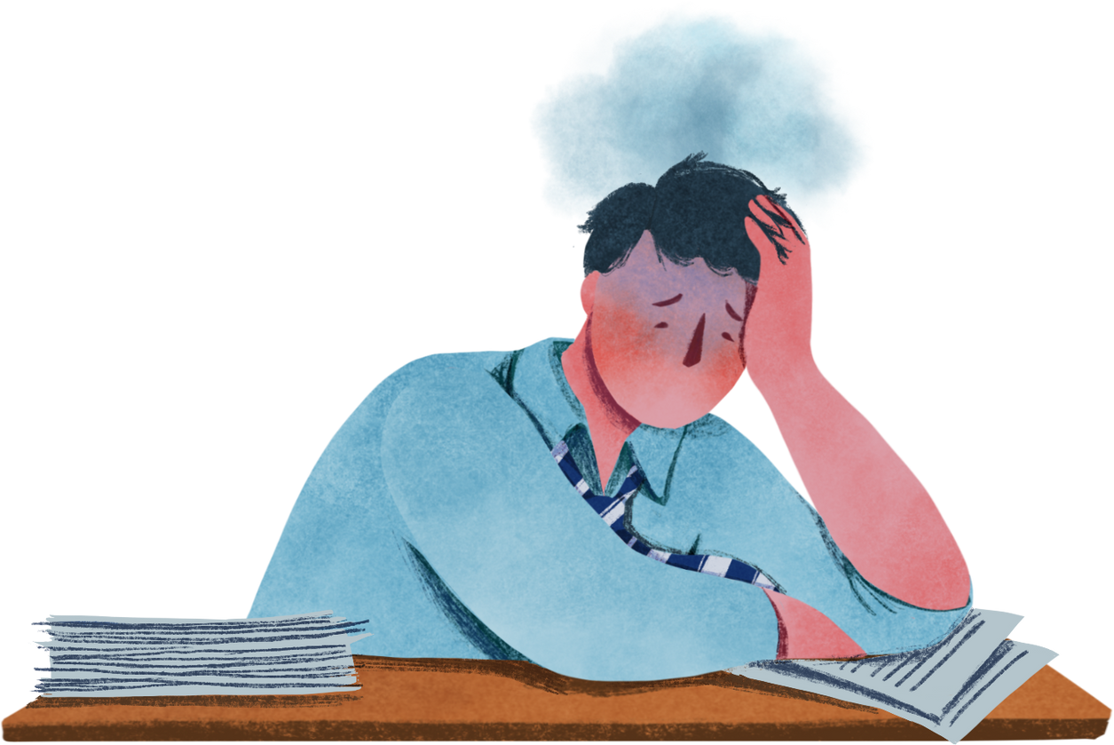
Exam Stress Example
Alarm reaction: You have trembling hands and butterflies in your stomach prior to the start of an important exam.
Resistance: You've finished your exam but you're having trouble switching gears and focusing on other things.
Exhaustion: Your exam is in the past but you still feel anxious and depressed. You're having trouble sleeping and you wonder how you're going to get through the rest of the semester.
Notes:
Any kind of stressor—both unpleasant and rewarding, dangerous or thrilling—can trigger general adaptation syndrome.

Slide 7
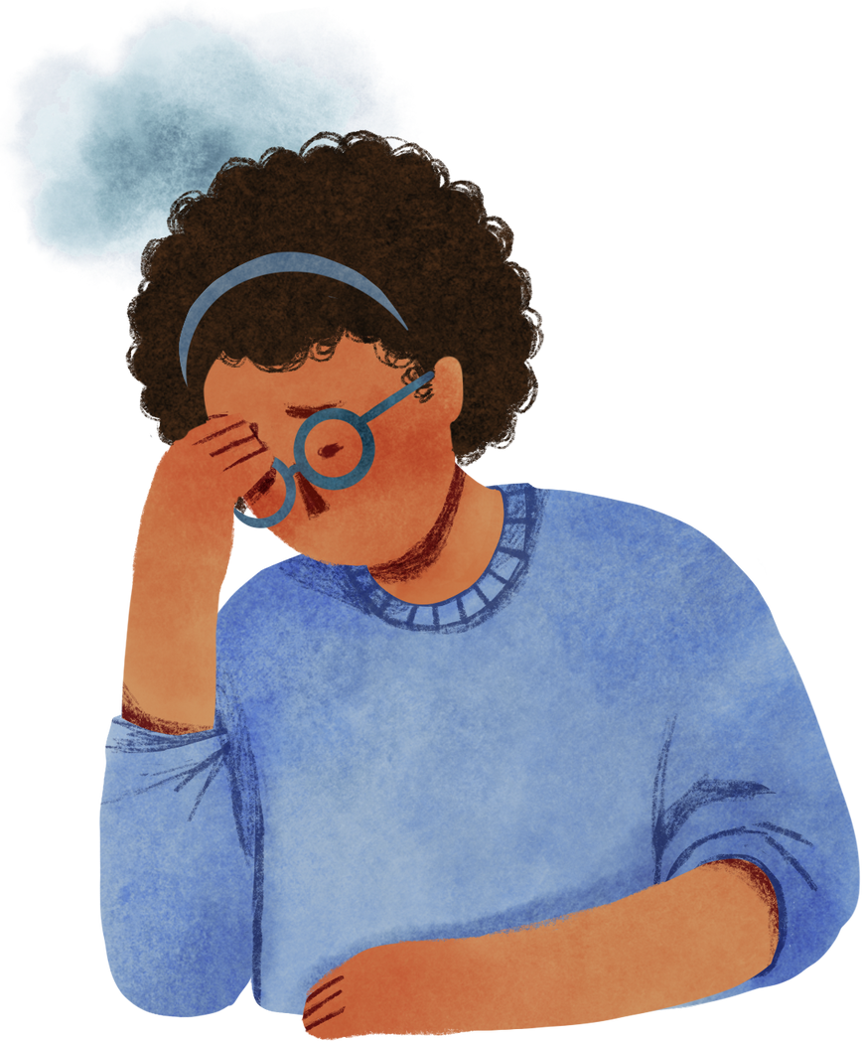
Why do we experience stress?
Many theories that explain why, but there are three in particular that are the most compelling and accepted:
Life-events theory
Hardiness theory
Social support theory

Slide 8
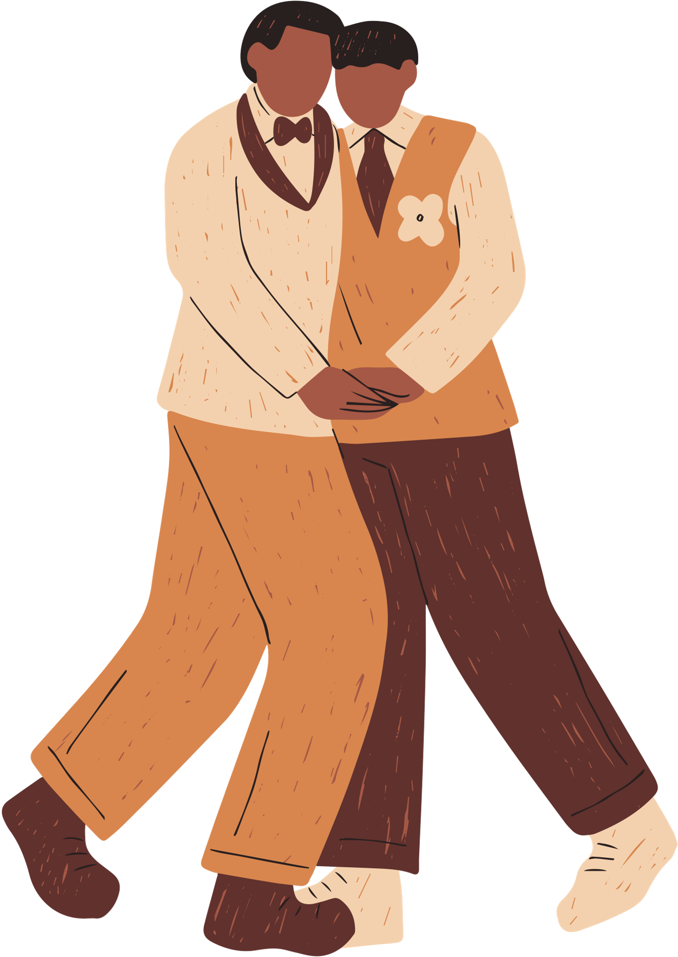

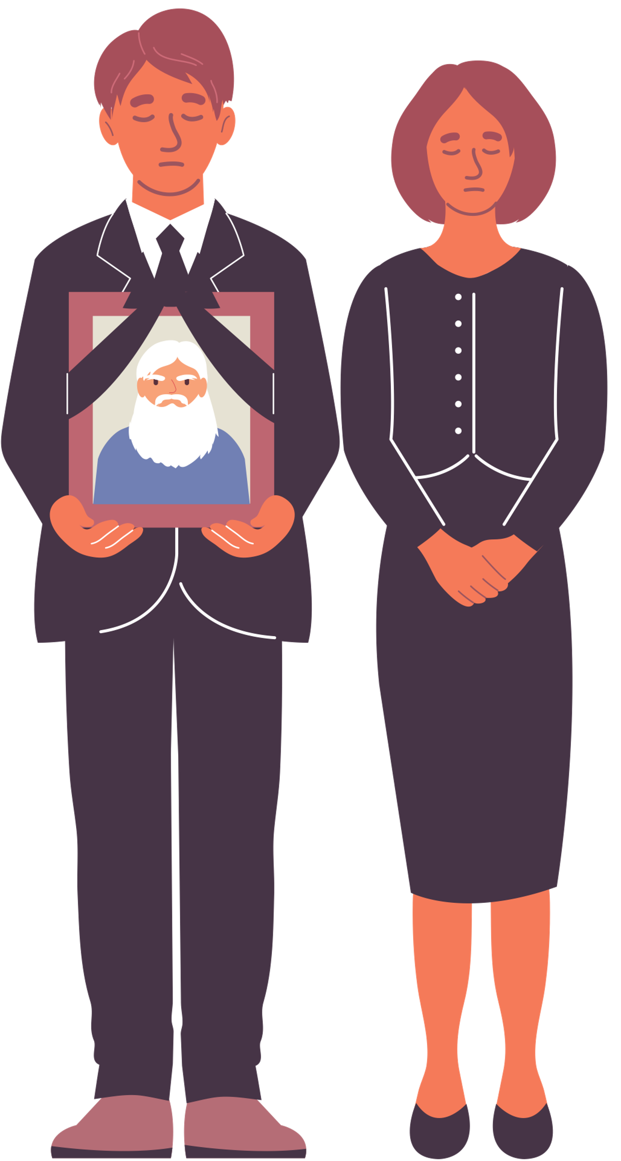
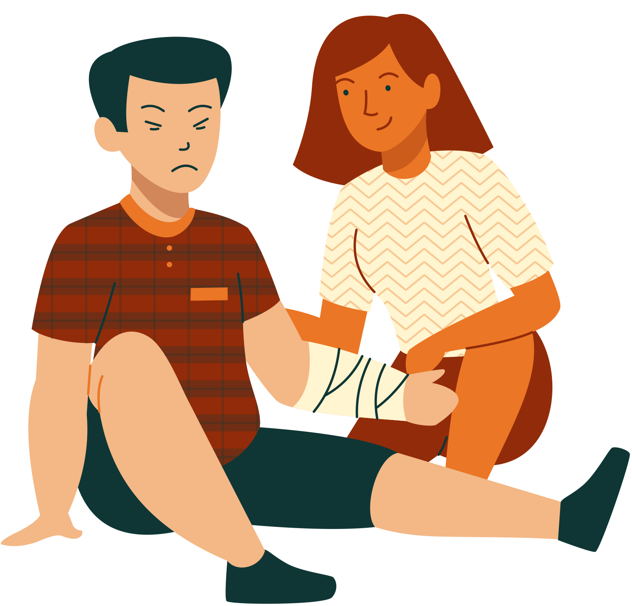
Life Events Theory
Stress occurs when a situation requires more resources than are available
Daily hassles are more stressful than major events
Allostatic load: Cumulative burden of chronic stress and life events, the "wear and tear" on the body
Notes:
Developed by Holmes and Rahe

Slide 9
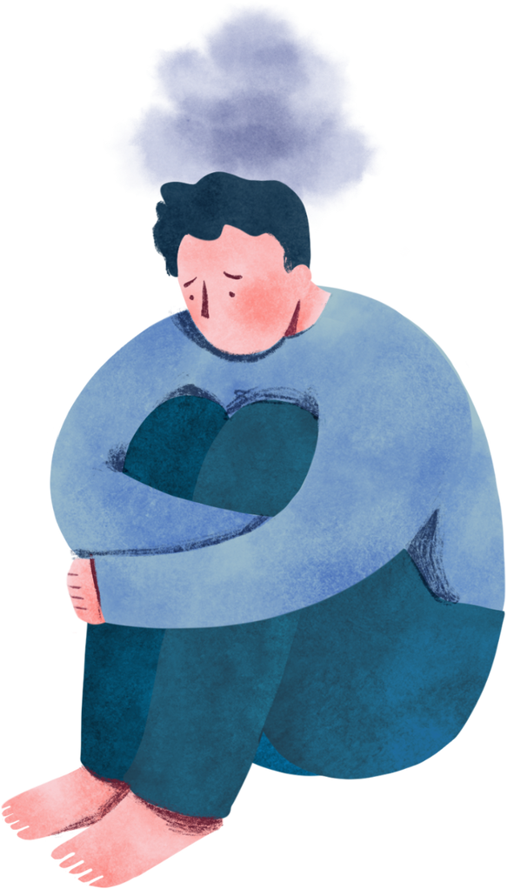
Additional
Stress Theories
Hardiness theory
Focuses on one’s attitude toward stressful events
Hardiness - Buffering between stress and the development of illness and disease
Social support theory
Stress occurs when there is not enough social support available to respond to the event effectively
Notes:
This is just a simple overview. We will learn more about this in upcoming lectures.
The stress management techniques that we will look at in this course are based on these theories. We will address how to manage resources, such as time and money, better so that you have can use resources wisely in stressful situations (life events theory). We will also address how you can change your attitude to stressful events so that they don’t affect you so acutely (hardiness theory). And lastly, they will address how you can develop better relationships in both your personal and professional life (social support theory).

Slide 10
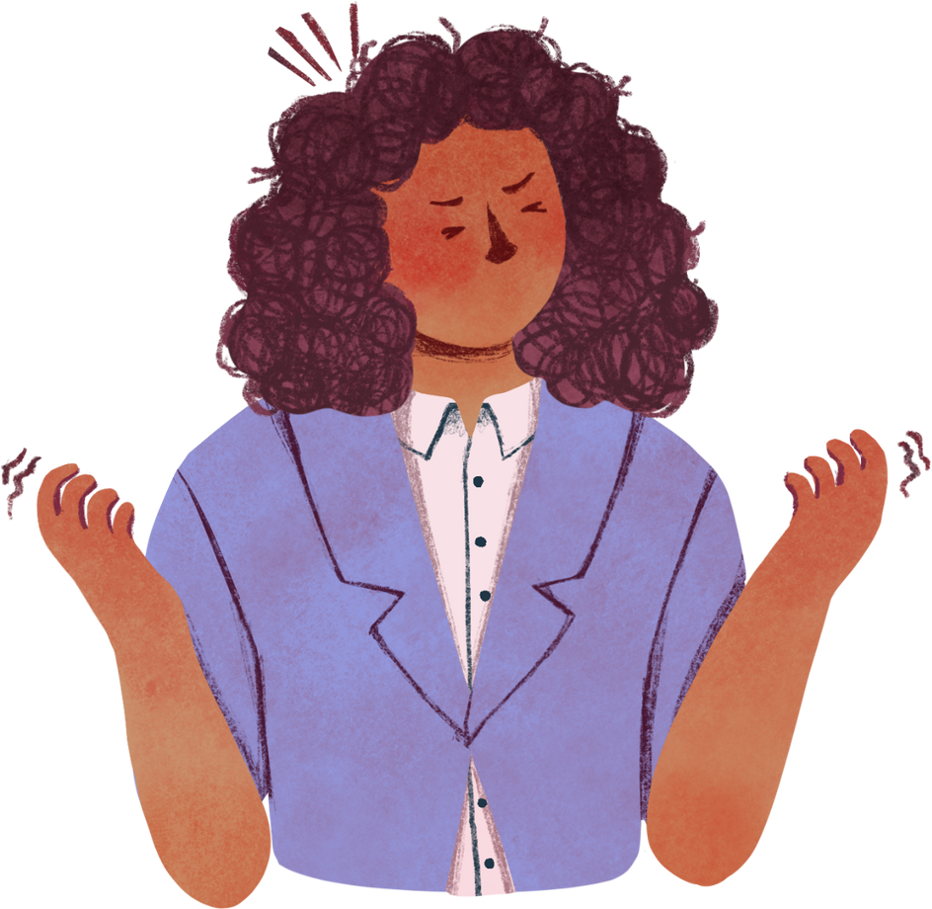
Stressor
Stimulus with the potential for triggering the fight-or-flight response
The human body has evolved to respond to stressors with an immediate action
Alters the physiology for greater speed and strength
Notes:
There are many other ways to conceptualize stress and its effects. Each, though, consists of at least two components: a stressor and stress reactivity.
Physical environment stress: bright lights, noise
Social/relational: rudeness or aggression in others, not spending enough time with important people, loneliness
Financial: taxes, unpaid bills, unplanned expenses
Lifestyle choices: not enough sleep, too much caffeine, too much alcohol

Slide 11
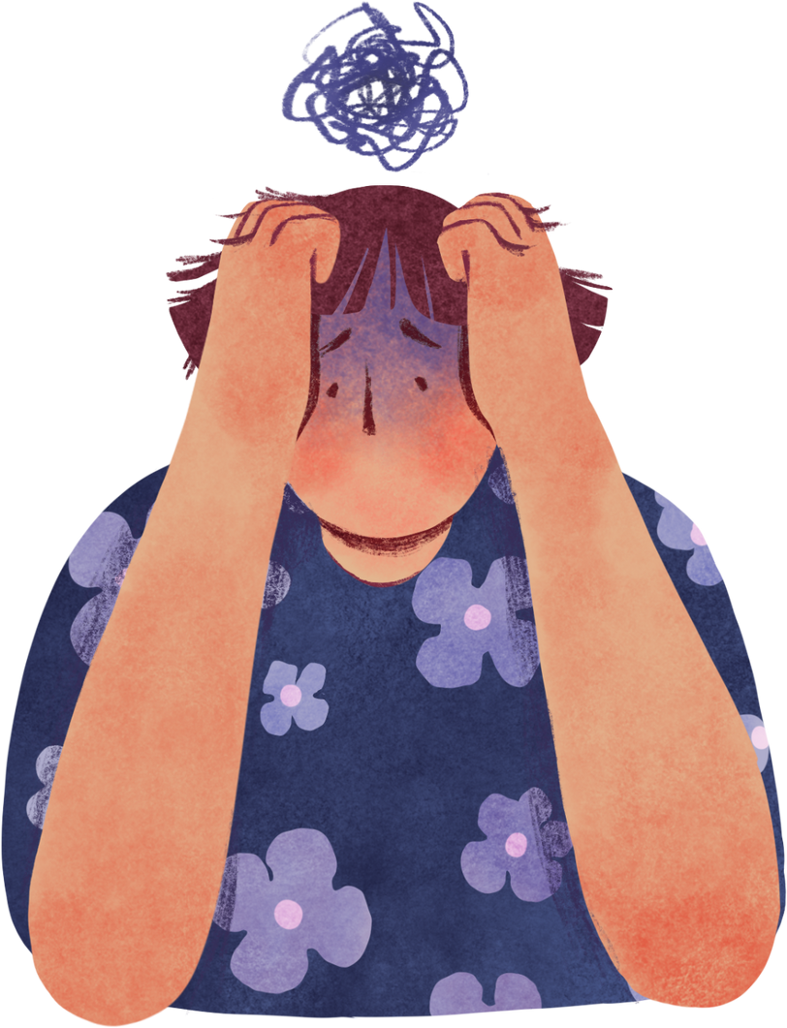
Stress Reactivity
Includes:
Increased muscle tension, heart rate, blood pressure, and perspiration
Change in respiratory rate and brain waves
Effects are based on duration and degree of one’s physiological reaction
Notes:
The fight-or-flight response is termed stress reactivity. Social conflict, social evaluation, failure at work, and work overload – everyone reacts differently. Things that stress you out might not stress out someone else.

Slide 12
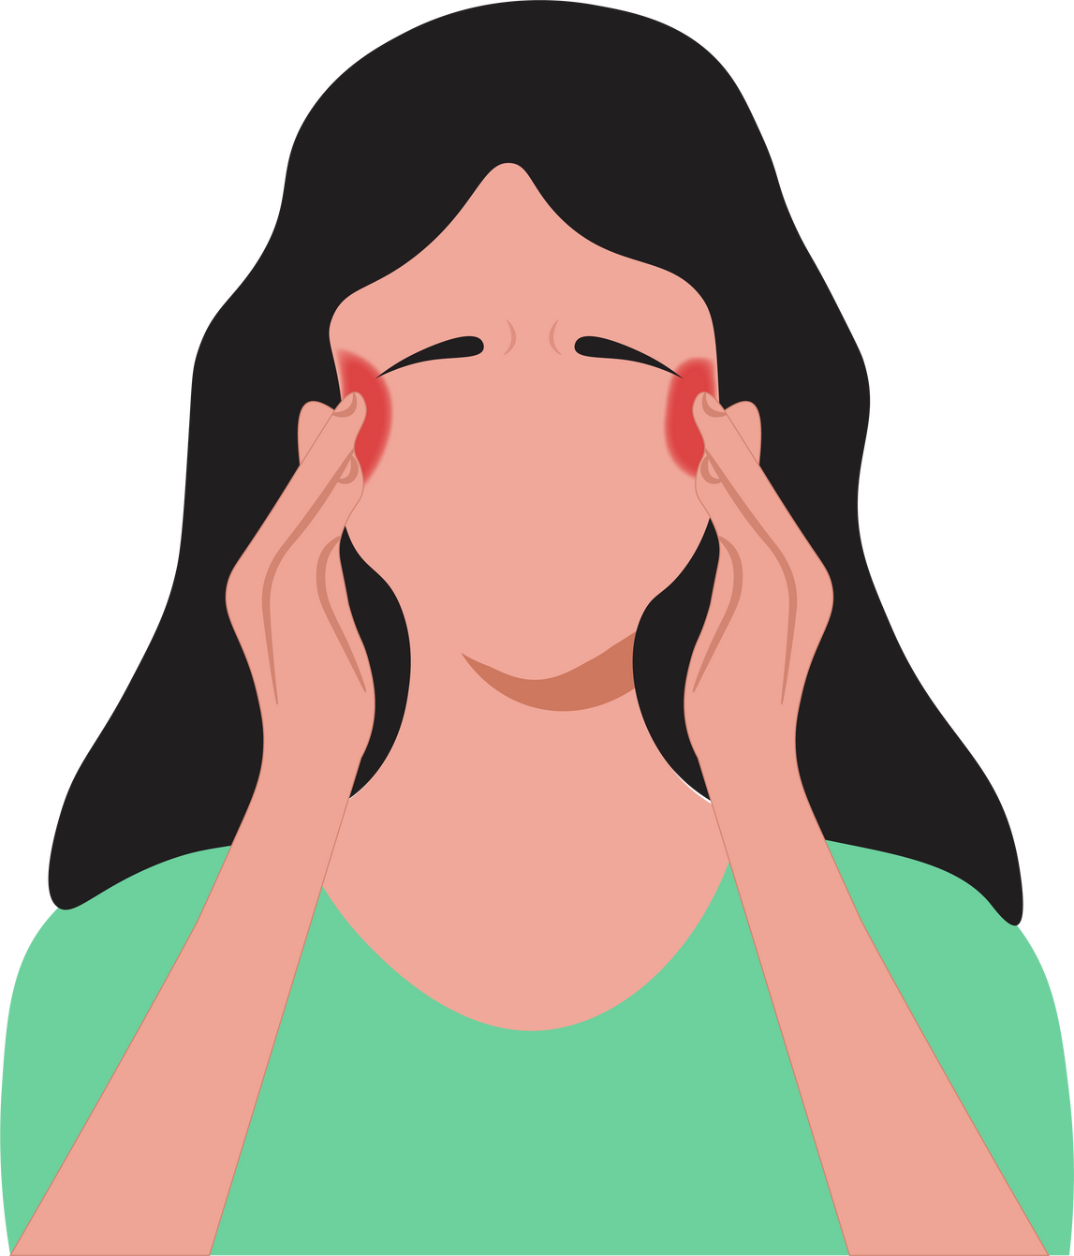
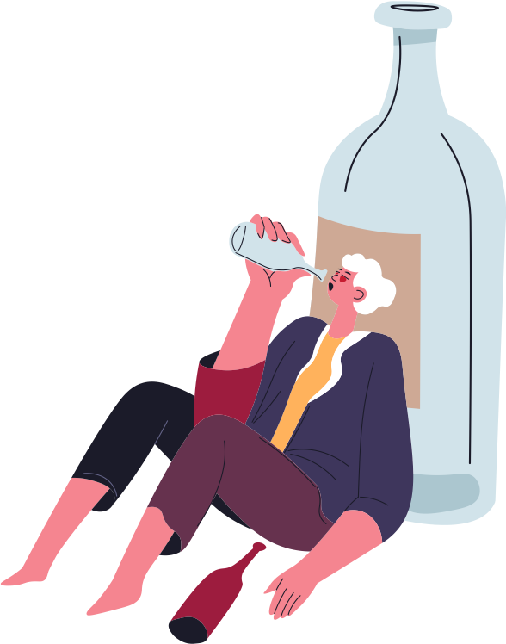
Strains
Outcome of stress reactivity
Physical strains
Ex. Tension headaches
Psychological
Ex. Agoraphobia
Behavioural
Ex. Alcohol abuse
Notes:
Strains are the observable effects of stress on a person's mental and physical well-being.
Social conflict, social evaluation, failure at work, and work overload – everyone reacts differently. Things that stress you out might not stress out someone else.

Slide 13
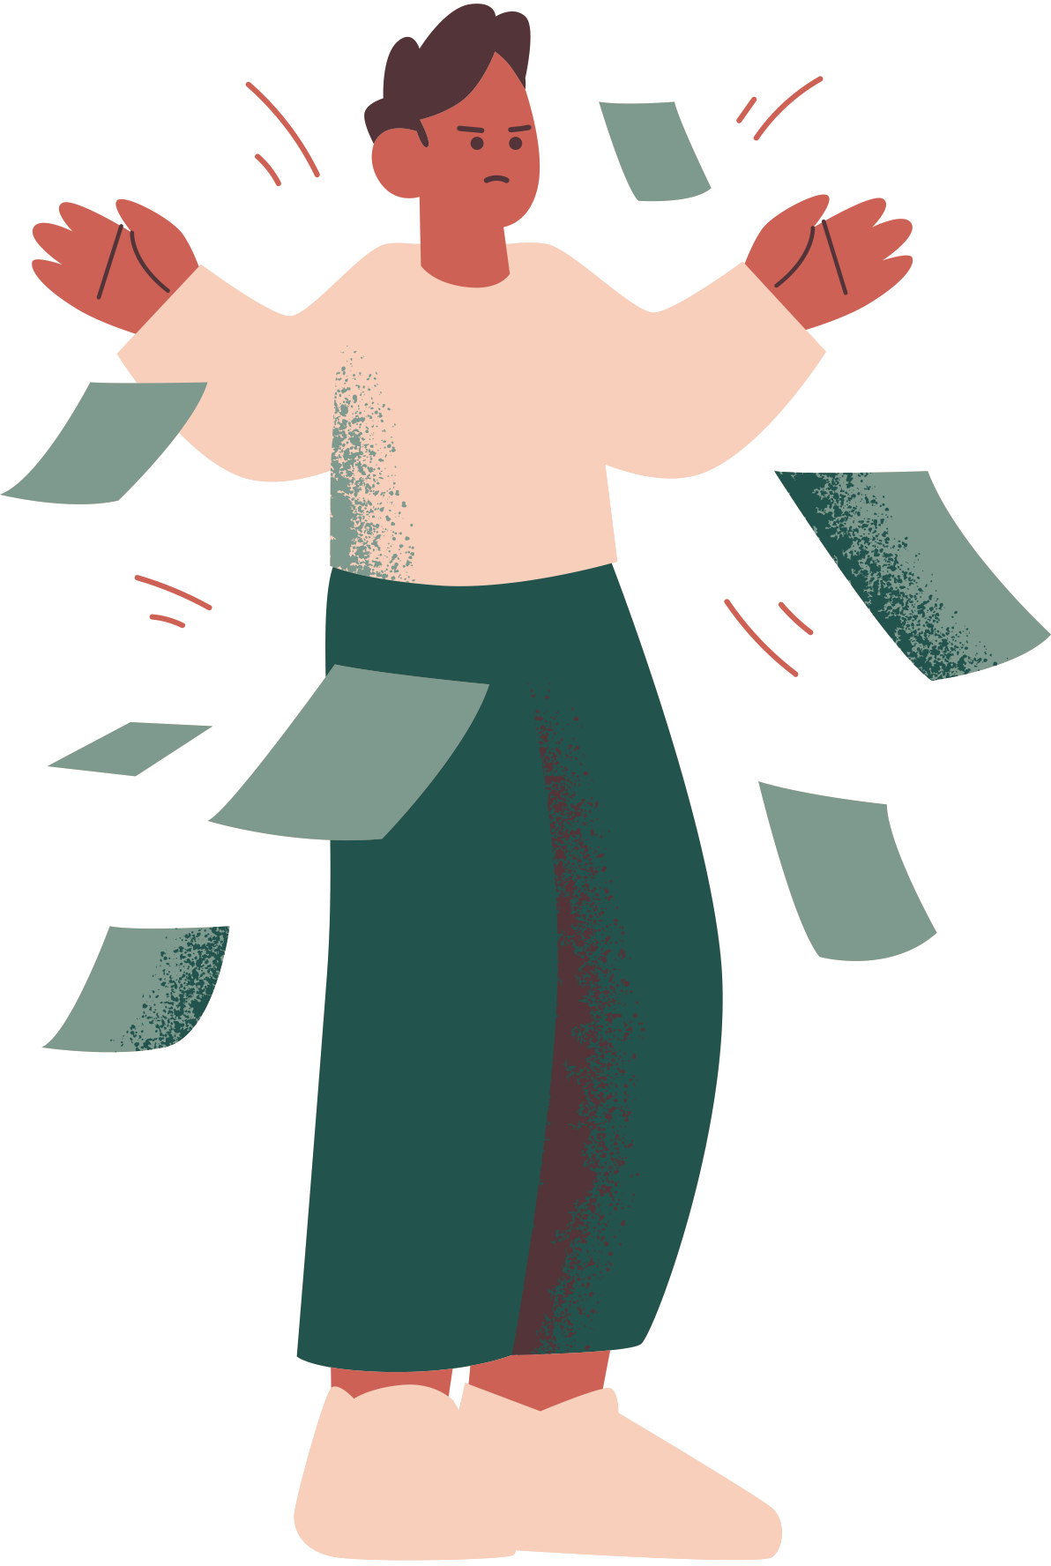
Types of Stress
Acute stress
Most common
Immediate response to a new challenge, event or demand
Normal reaction to abnormal events
Episodic stress
When acute stress happens too frequently
Often happens to people who take on too much- feels pressured
Often affects people who worry all the time
Notes:
Acute stress is the most common form of stress. It comes from demands and pressures of the recent past and anticipated demands and pressures of the near future. Recognizable: car accident, a deadline coming up, writing a test. Acute stress can crop up in anyone's life, and it is highly treatable and manageable.
Episodic stress: those who suffer acute stress frequently, now have episodic stress. Their lives are so disordered that they are studies in chaos and crisis. They're always in a rush, always late. If something can go wrong, it does. They take on too much. It is common for people with acute stress reactions to be over aroused, short-tempered, irritable, anxious and tense.

Slide 14
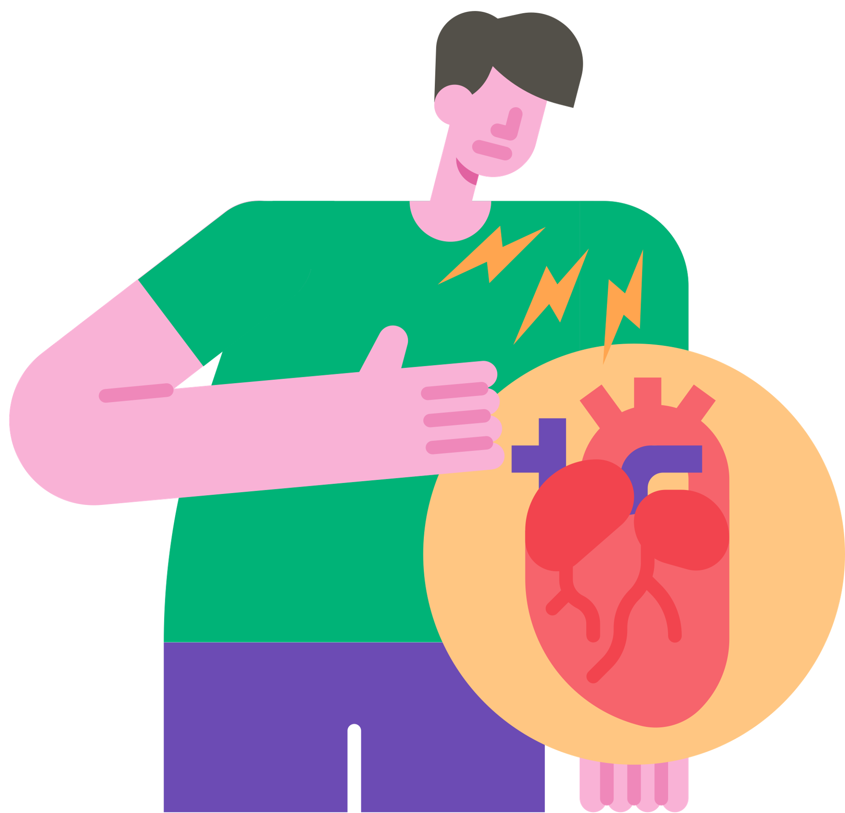
Types of Stress
Chronic stress
Acute stress that lasts for long periods of time
People mistaken stress for being “normal”
Can lead to cancer, strokes, and heart attacks, as well as violent behaviour and even suicide
Notes:
Chronic stress: Part of what makes chronic stress so insidious is its ability to become “normal” feeling. Poverty, trauma, general pressure from the demands of life, and more can all cause chronic stress. Chronic stress can lead to cancer, strokes, and heart attacks, as well as violent behavior and even suicide.

Slide 15
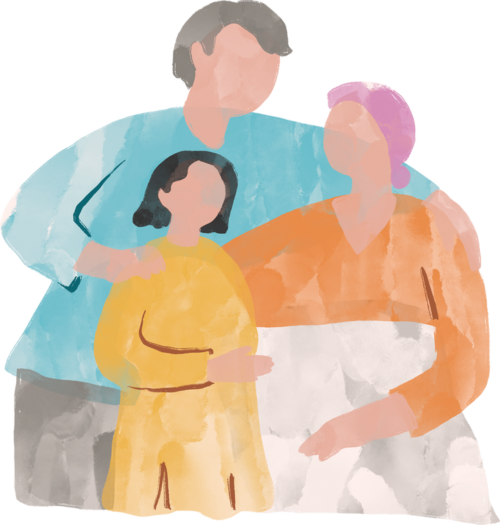
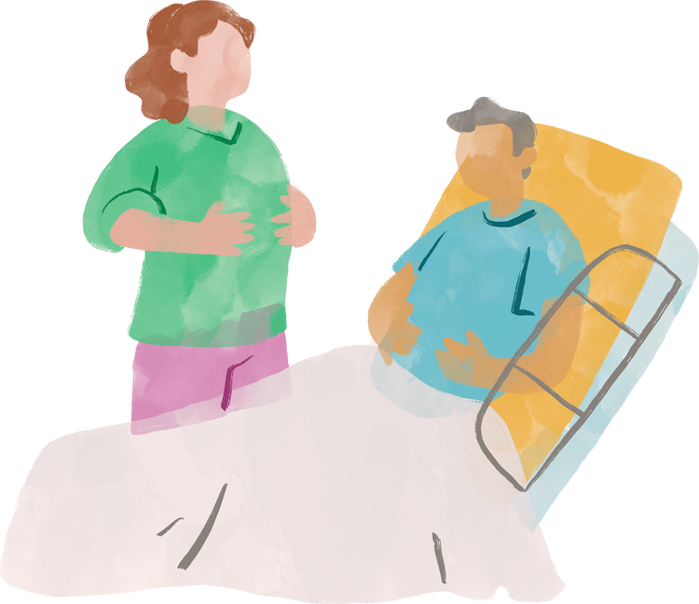
Positive Stress
Negative Stress
EUSTRESS
Good things to which one must adapt and that can lead to a stress reaction
E.g., Becoming a parent
DISTRESS
Bad things to which one has to adapt and that can lead to a stress reaction
E.g., An illness
Notes:
Eustress, or positive stress, has the following characteristics:
Motivates, focuses energy, Is perceived as within our coping abilities, Feels exciting, Improves performance.
Ex. Receiving a promotion or raise at work, starting a new job, planning a vacation.
Distress, or negative stress, has the following characteristics:
Causes anxiety or concern. Is perceived as outside of our coping abilities, Feels unpleasant, Decreases performance, Can lead to mental and physical problems.
Ex. The death of a spouse, Filing for divorce, Losing contact with loved ones.

Slide 16
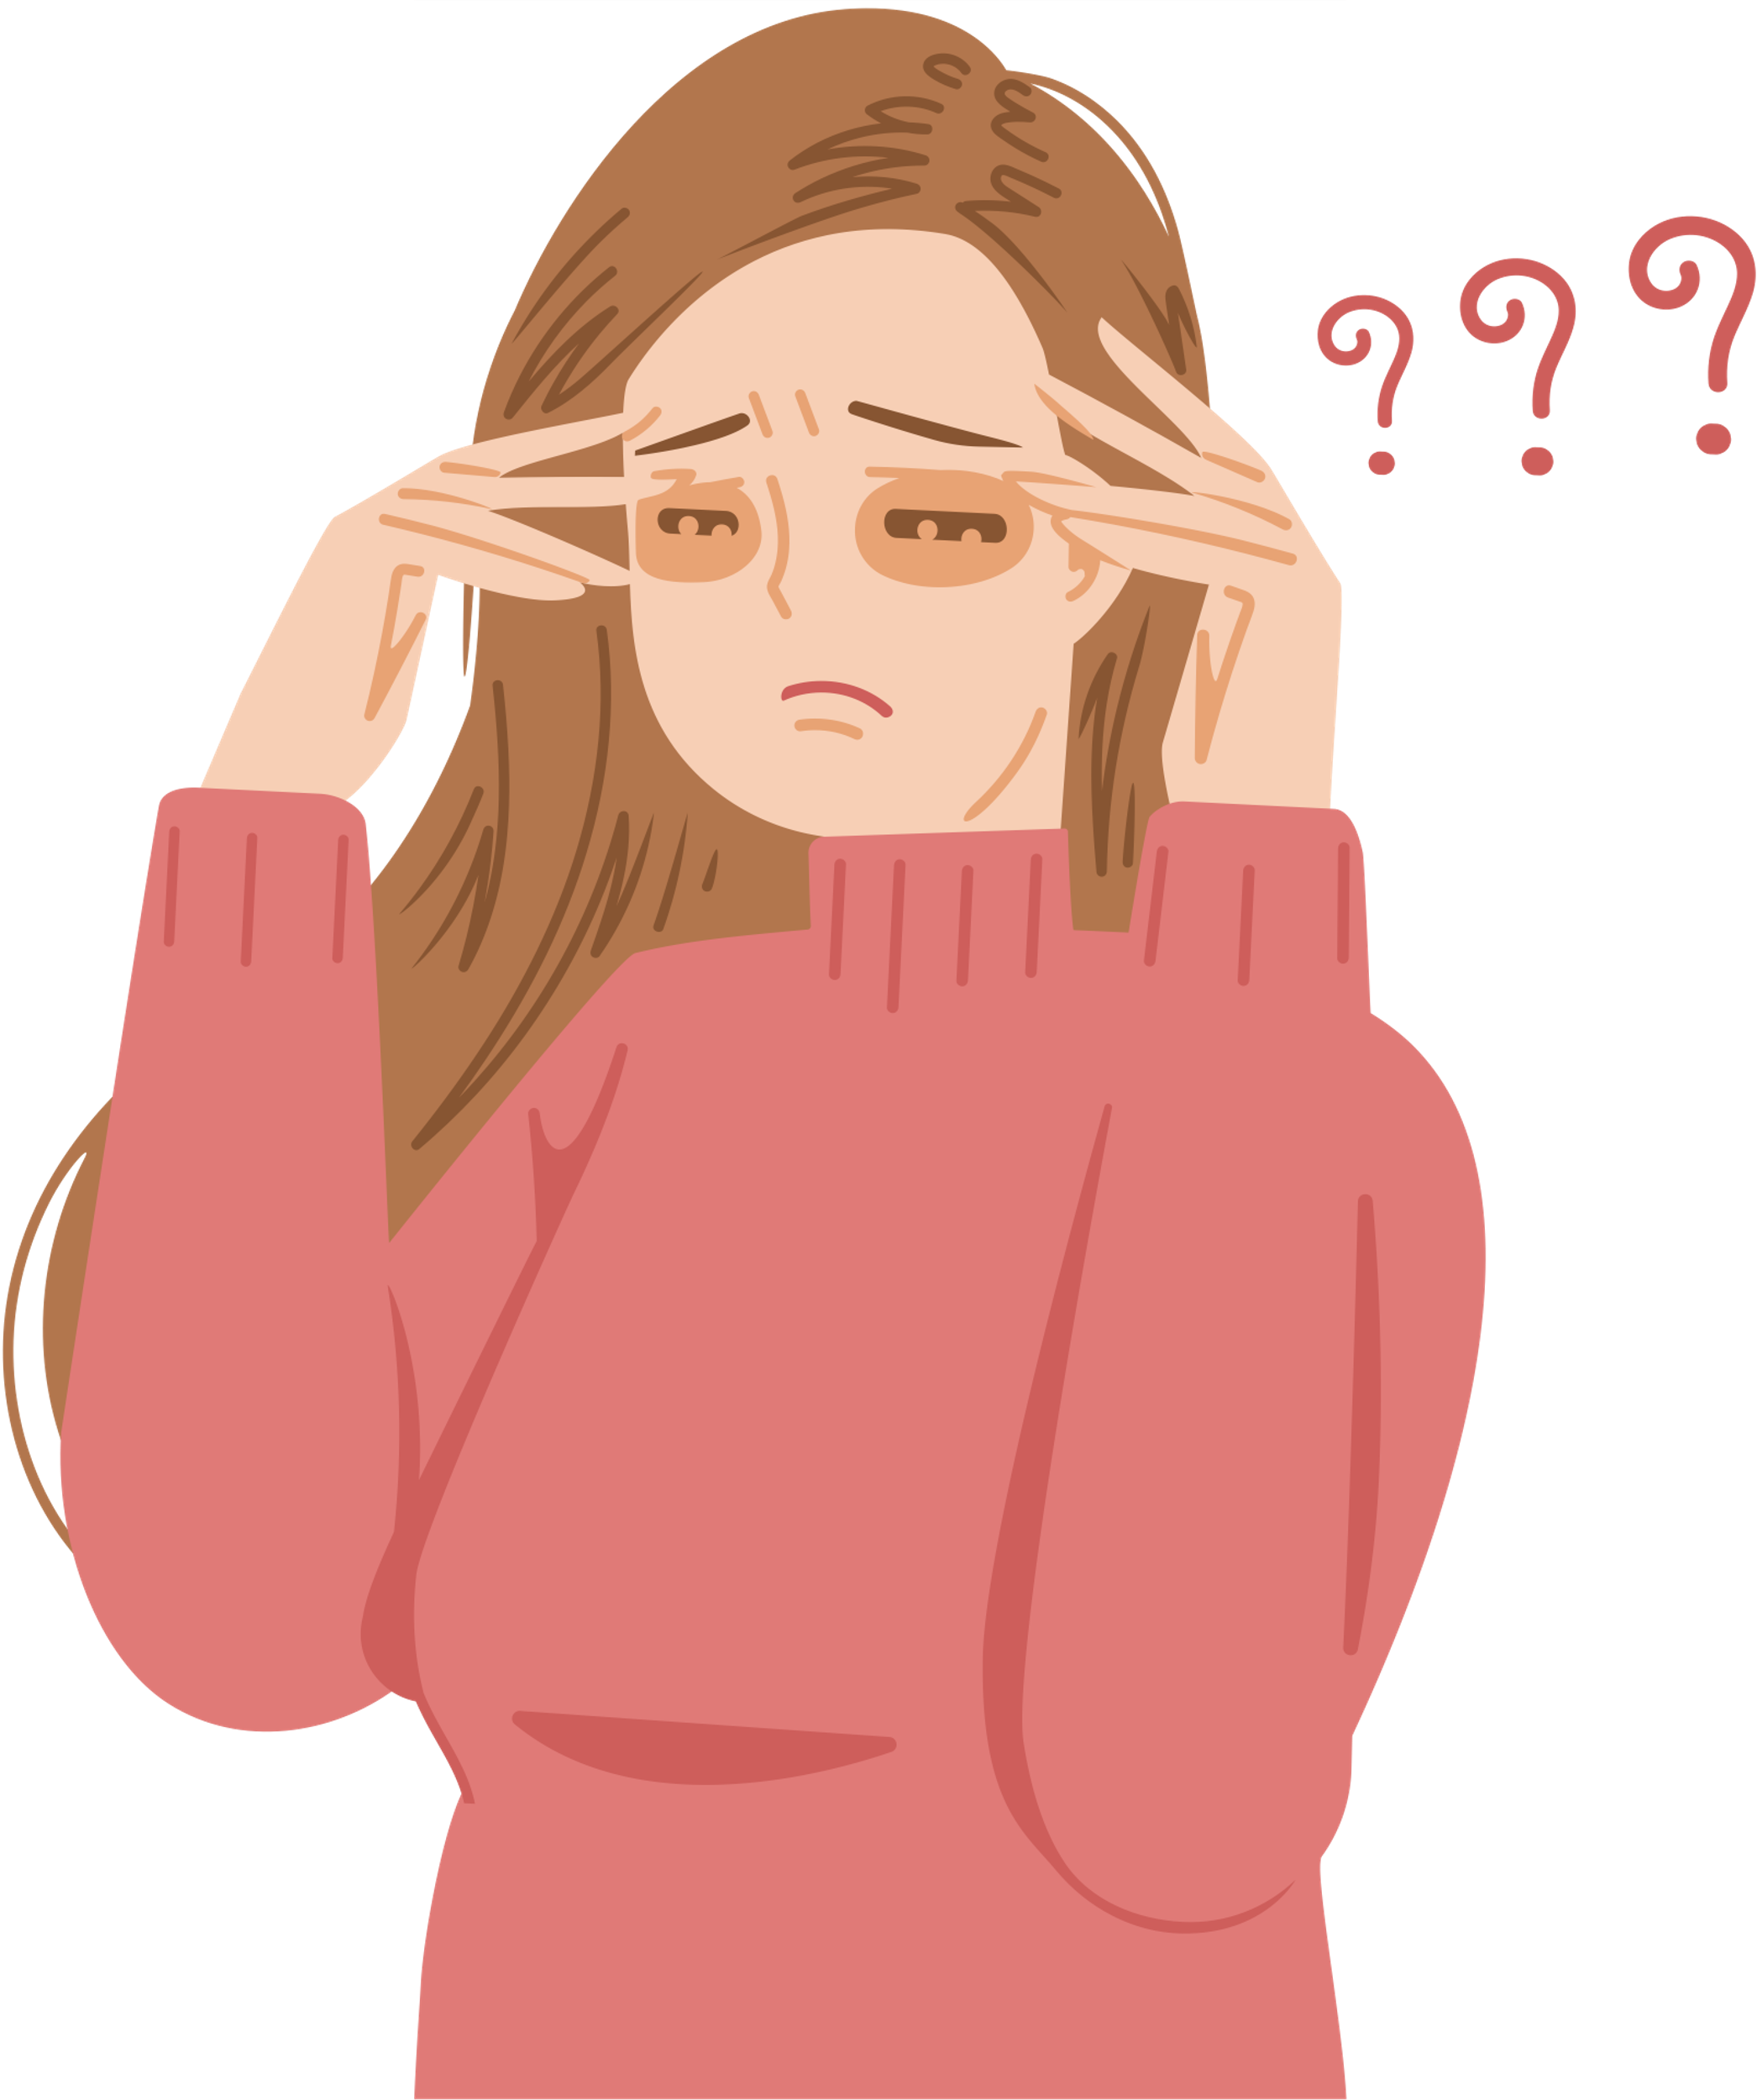
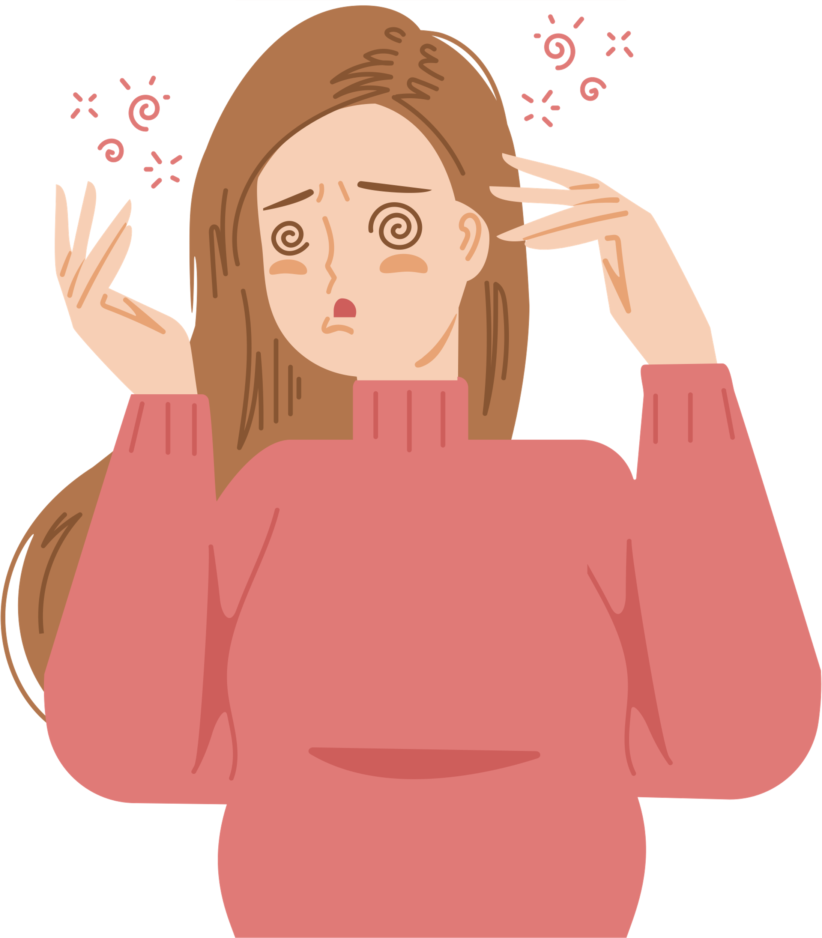
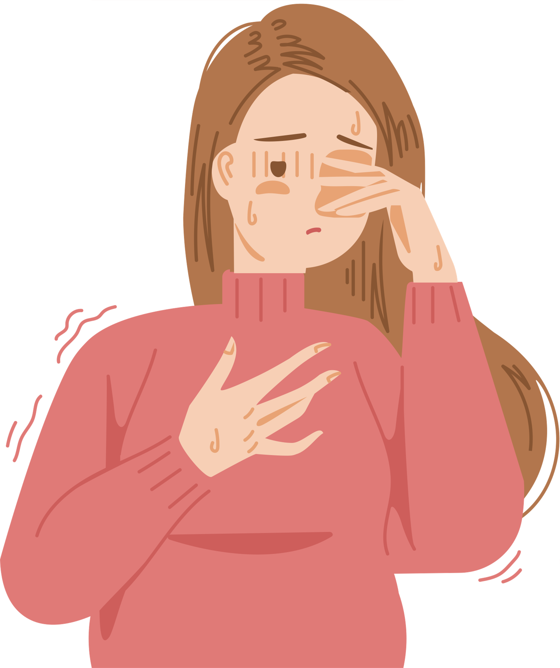
Symptoms of Stress Reaction
PHYSICAL | COGNITIVE | BEHAVIORAL | EMOTIONAL
Fatigue | Poor attention/ concentration | Change in activity | Anxiety
Grinding teeth | Nightmares | Loss of appetite | Guilt
Headaches | Blaming others | Alcohol consumption | Irritability
Muscle cramps | Poor problem solving | Withdrawal | Uncertainty

Slide 17
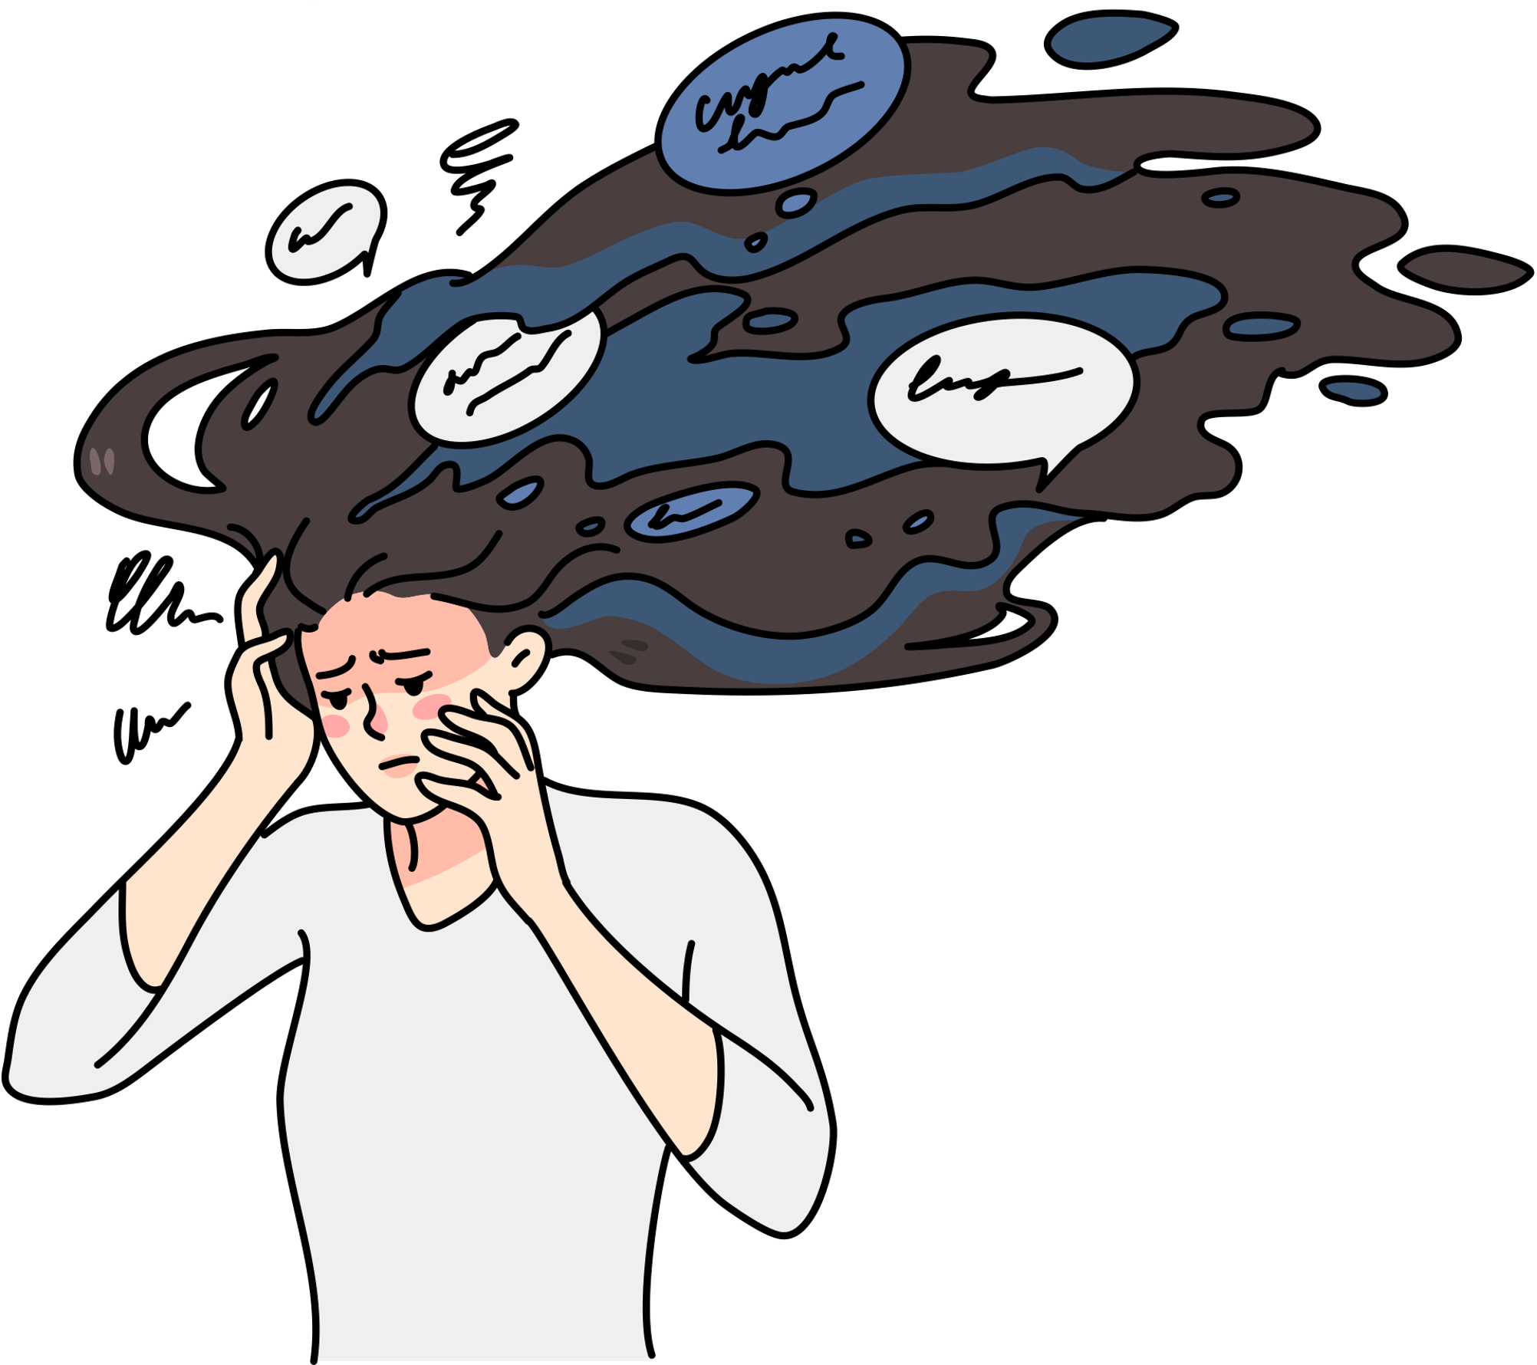
Cost of Stress
Biological consequences
Generates a rise in hormone secretions by adrenal glands
Increase heart rate and blood pressure
Psychological consequences
View of the environment is clouded
Extreme emotional responses
Less able to deal with new stressors
Notes:
Stress can have an effect on your mind and your body and even cause great harm!

Slide 18
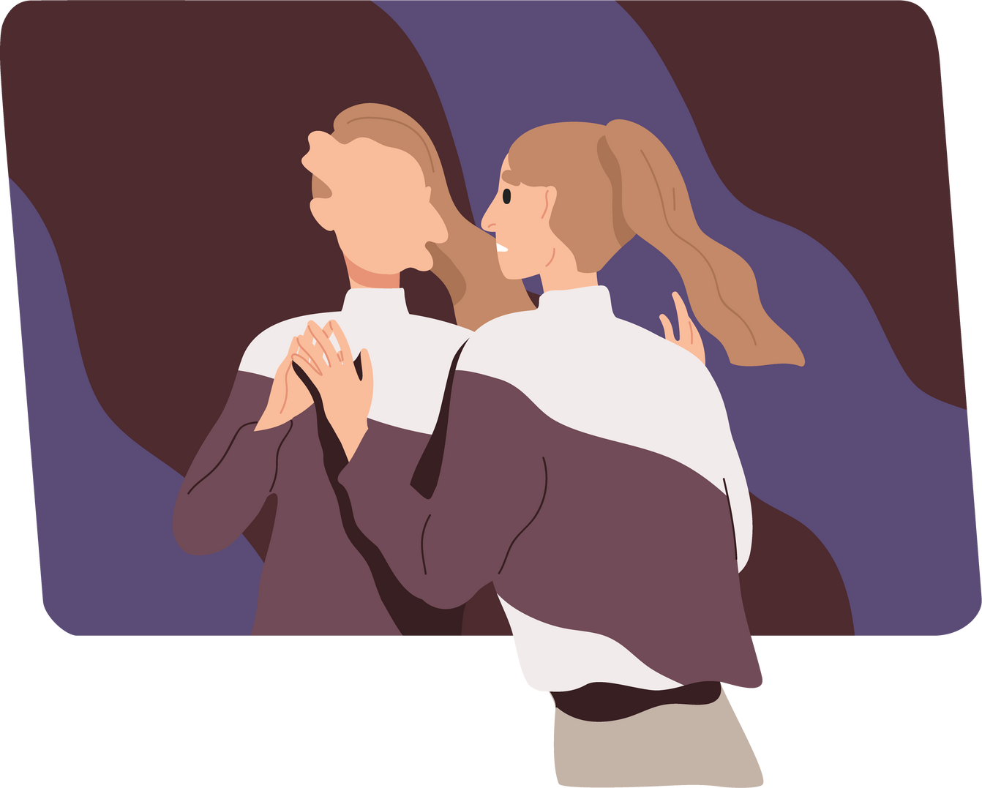
Perceptions of Stress
A situation can be stressful or not -- it depends on your perception of the event
A response to stress can be effective or not -- it depends on your resources and coping strategies

Slide 19
Stressors | Valerie (Stress Profile) | Vincent (Healthy Profile)
Alarm clock doesn't go off. Late for class. | Thoughts: My professor will be angry with me. I've been late several times already. Stress Reactivity: Muscles tension, heart races, start to perspire. Strain: Stomach upset, leaves hungry, chooses clothes that do not match. | Thoughts: I'll take care of this. I will explain that it was an accident and apologize to the professor. Stress Reactivity: None Strain: None
Burned the toast at breakfast and spilled coffee on the floor. | Thoughts: Seriously?? I cannot do anything right today. Stress Reactivity: Breathing rate increases, heart feels like it is pounding in the chest, and feels frustrated. Strain: Gets headache, diarrhea, and burns hand on the toaster. | Thoughts: Well, I am already late. I'll just toast another slice of bread and clean up the spilled coffee. Then I'll head to class. Stress Reactivity: None Strain: None
Notes:
A Comparison Between Valerie and Vincent's Stressful Day

Slide 20
Stressors | Valerie (Stress Profile) | Vincent (Healthy Profile)
Computer crashes and file for term paper is lost. | Thoughts: Are you kidding me??! Now have to type this whole term paper over and stay up late to get it done. Stress Reactivity: Feeling frustrated and angry, forehead muscles tense, and can't concentrate. Strain: Develops tension headache, can't remember what they previously wrote, makes numerous grammatical errors when retyping the paper. | Thoughts: How should Vincent respond? Stress Reactivity: None Strain: None
Having difficulty learning the material for an important exam. | Thoughts: I'm a stupid idiot. I'll never learn this material and honestly, I'm probably going to fail the exam. Stress Reactivity: Angry, fists clench, an overwhelming fear of failing, and eyes get tired and can't concentrate Strain: Argues with roommate to keep quiet, unable to decide what what to focus on, and considers dropping class to avoid the test. | Thoughts: How should Vincent respond? Stress Reactivity: None Strain: None
Notes:
A Comparison Between Valerie and Vincent's Stressful Day

Slide 21

Portrayal of Stress in The Bear
Learn about perceptions of stress through the TV show "The Bear,“ which portrays stress in commercial kitchens and family dynamics.
How does the show distinguish between eustress (beneficial stress) and distress (negative stress)?
Notes:
Watch the first 3.5 minutes of the video- the rest is optional.
May contain minor spoilers from Season 2, if you’re worried about spoilers, can you skip this video entirely ☺

Slide 22
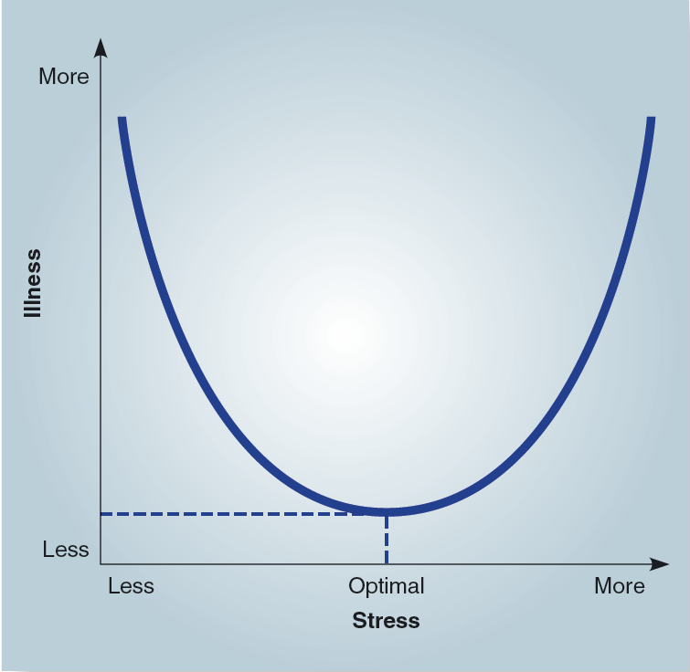
Relationship Between Stress and Illness
Notes:
The higher levels of stress, the more likely one is to get ill. In your personal life, did you notice yourself getting sick more easily during exam periods?

Slide 23
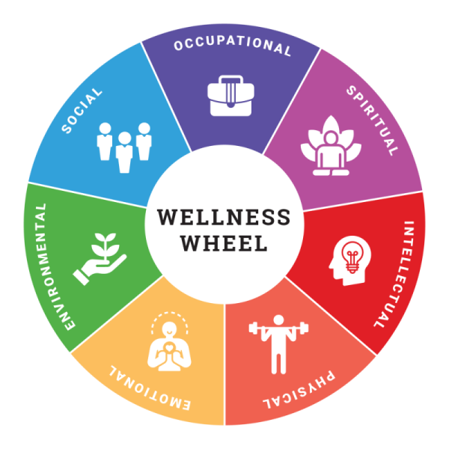
Wellness
Wellness is a holistic view of health that ensures we are able to achieve our full potential.
Multidimensional view, that recognizes that well-being is more than just having a healthy body.
Seven Dimensions of Wellness:
Physical
Social
Intellectual
Emotional
Spiritual
Environmental
Occupational
Notes:
Physical health - the ability to perform daily tasks without undue stress or fatigue, and the maintenance of healthy habits over destructive habits (ie. drinking water instead of smoking cigarettes). Tips for boosting physical health include eating better, implementing a regular exercise routine and cutting down on destructive habits such as alcohol consumption.
Social health - the ability to relate to others and maintain positive and loving relationships. Tips for better social health include writing a letter of appreciation to someone special in your life, or even asking someone how their day is going and taking the time to listen.
Intellectual health - engaging in activities that challenge your mental abilities, learning new things, partaking in creative activities and expanding knowledge. Tips to stimulate your intellectual side: go to your local library, listen to some TED talks more regularly, or start a weekly crossword habit.
Emotional health - the ability to understand ourselves and express all feelings (happiness, anger, sadness, fear) in a way that is productive. Do something for no other reason than the fun of it—pack a picnic, watch a funny movie, dance along to an oldies CD.
Spiritual health - the ability to act in accordance with our values and work towards a greater purpose. Write down the things you value, and practice those values. Show compassion. Practice acceptance. Spend some time in quiet prayer or listening to your breath.
Environmental health - being in and contributing to an environment that is clean and healthy (ie. clean air, clean water, minimal clutter or minimal contact with hazardous materials). This can mean taking walks in nature, picking up litter in your local park, living in and maintaining a clean home, or ensuring proper safety equipment at your workplace.
Occupational health - finding fulfillment through work while also maintaining a healthy work-life balance (ie. not over-working). You can improve this by starting a meaning

Slide 24
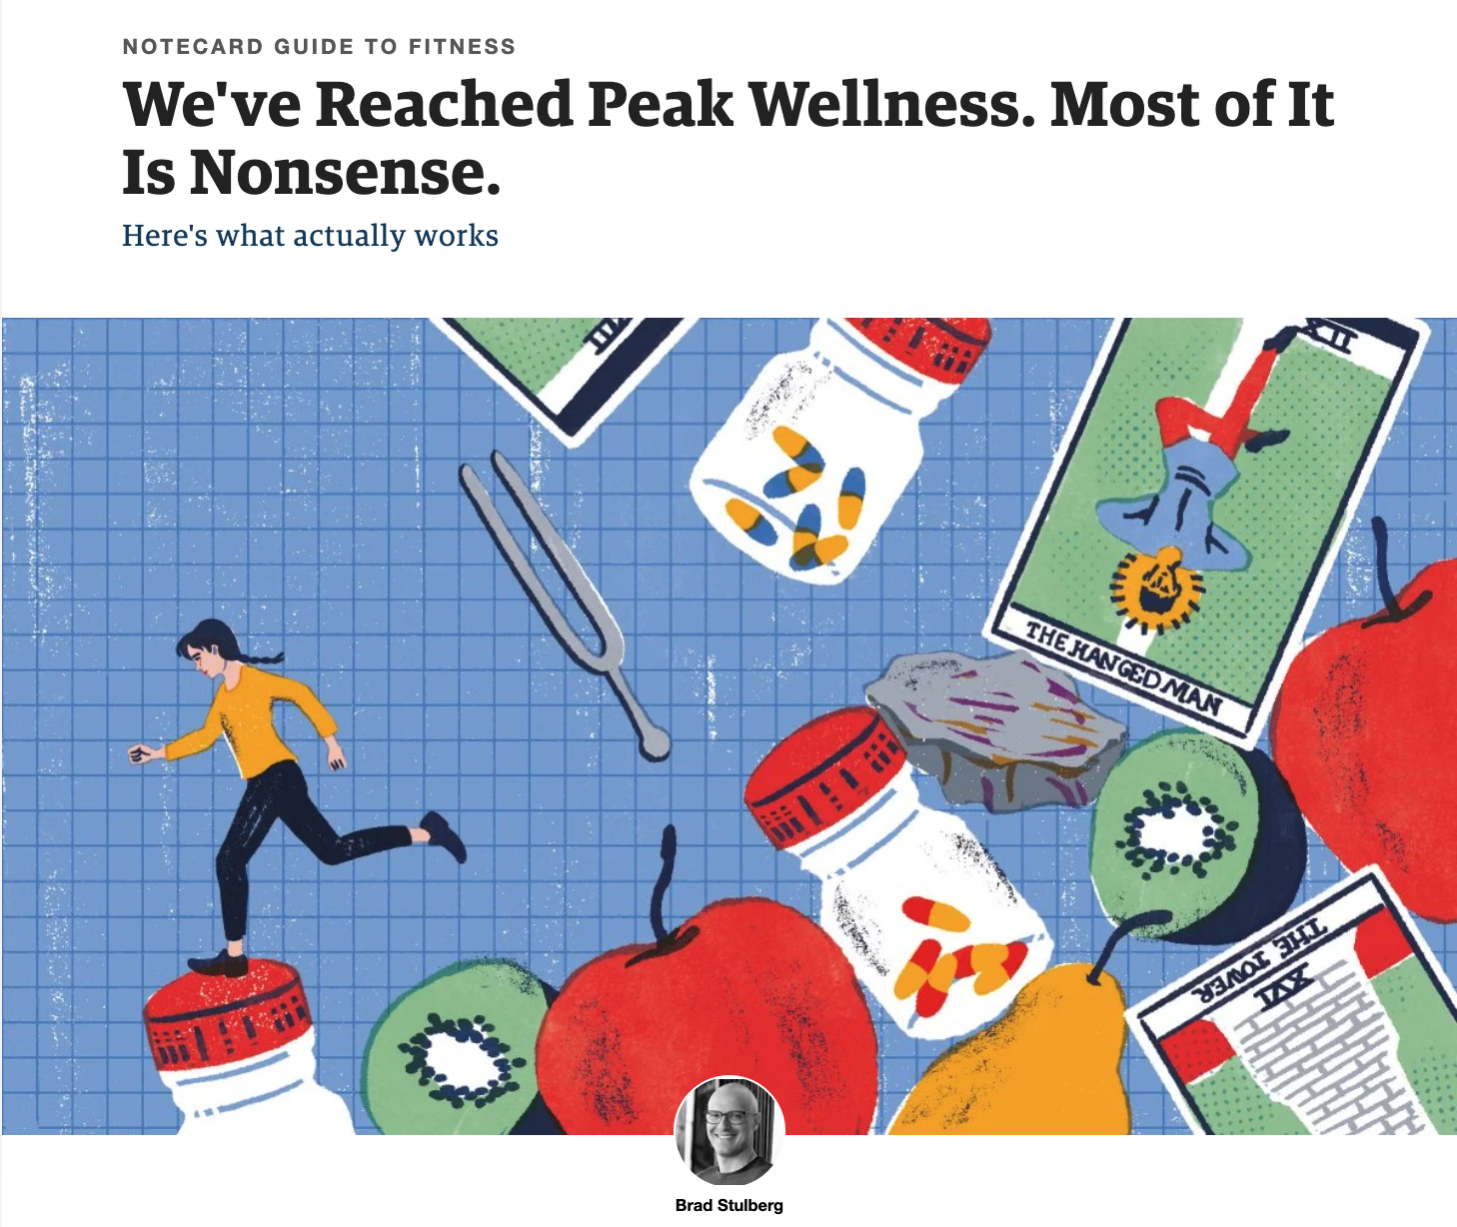
Notes:
Please read this article by Brad Stulberg:
https://www.outsideonline.com/health/wellness/wellness-industry-lies-what-really-works/
Based on the 6 dimensions of wellness: physical, emotional, social, cognitive, spiritual, environmental.
Practice your understanding: Summarize each dimension and discuss how well you’re currently doing in that dimensions, and ways to improve.

Slide 25
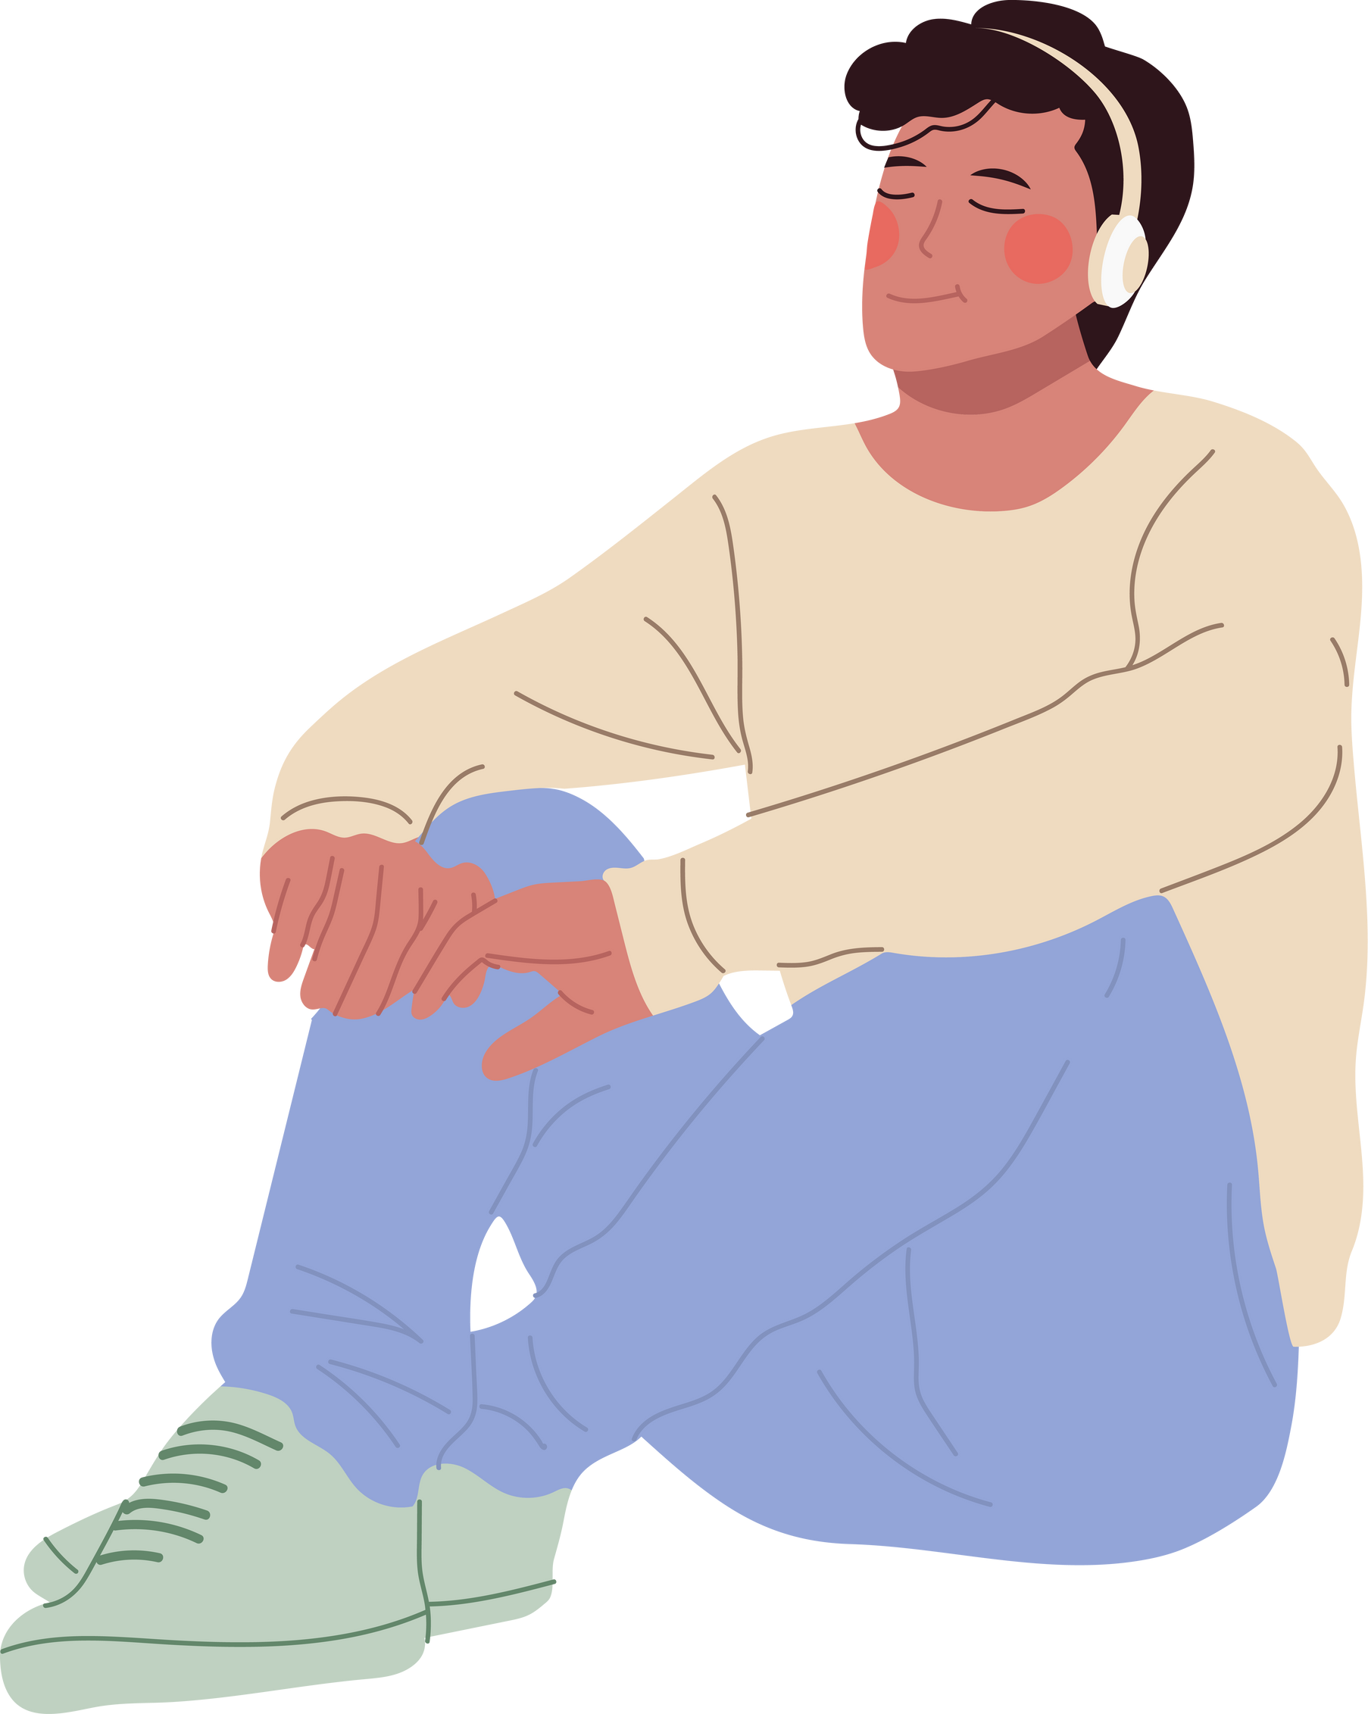
Goals for Stress Management
Try to limit the harmful effects of stress
Use as a motivator for peak performance
Stress can be useful, stimulating, and welcome
Culture of wellness is made up of features that encourage, reward, and support wellness choices
Notes:
It’s impossible to be completely stress-free, but we can be better prepared for stressful situations in the future when we know how to react to it.

Slide 26
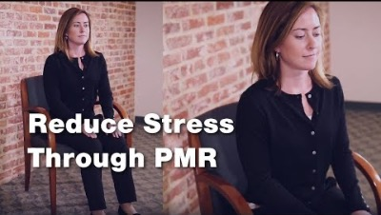
Mindful Moment
Notes:
https://www.youtube.com/watch?v=ClqPtWzozXs

